Slide 1
Deep Learning Seminar Day-3

Slide 2
Fast review of Day-1 concepts
http://r2rt.com/recurrent-neural-networks-in-tensorflow-i.html
http://www.wildml.com/2016/08/rnns-in-tensorflow-a-practical-guide-and-undocumented-features/
http://colah.github.io/posts/2015-08-Understanding-LSTMs/
https://danijar.com/introduction-to-recurrent-networks-in-tensorflow/
http://www.wildml.com/2016/04/deep-learning-for-chatbots-part-1-introduction/

Slide 3
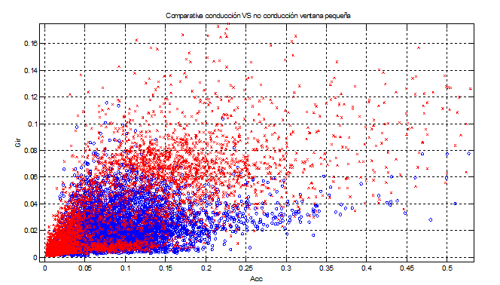
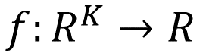
From linear classifiers TO Neural Networks
Nonlinear decision function?
No-driving=0
$$f:R^{K}→R$$
Driving=1

Slide 4
From linear classifiers TO Neural Networks
Use a very generic as kernel machines (e.g. SVM, RBF kernel)
To manually engineer
The strategy of deep learning : to learn

Slide 5

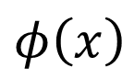
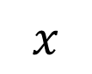
Hand-crafted
kernel function
From: DL Tutorial
Hung-yi Lee
SVM
Apply simple classifier
Source of image: http://www.gipsa-lab.grenoble-inp.fr/transfert/seminaire/455_Kadri2013Gipsa-lab.pdf
Deep Learning
simple classifier
Learnable kernel
$$φ\left(x\right)$$
……
y₁
$$x$$
……
y₂
…
…
…
…
…
……
y_{M}

Slide 6
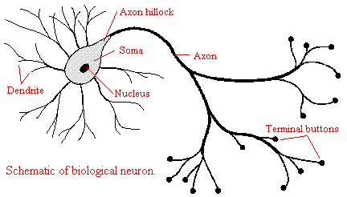
From linear classifiers TO Neural Networks
The DL approach: learn
…from a broad class of functions

Slide 7
From linear classifiers TO Neural Networks
Neuron approach….
…
Cumulative
influence
synaptic weights
Activation
Function
“all or none”

Slide 8
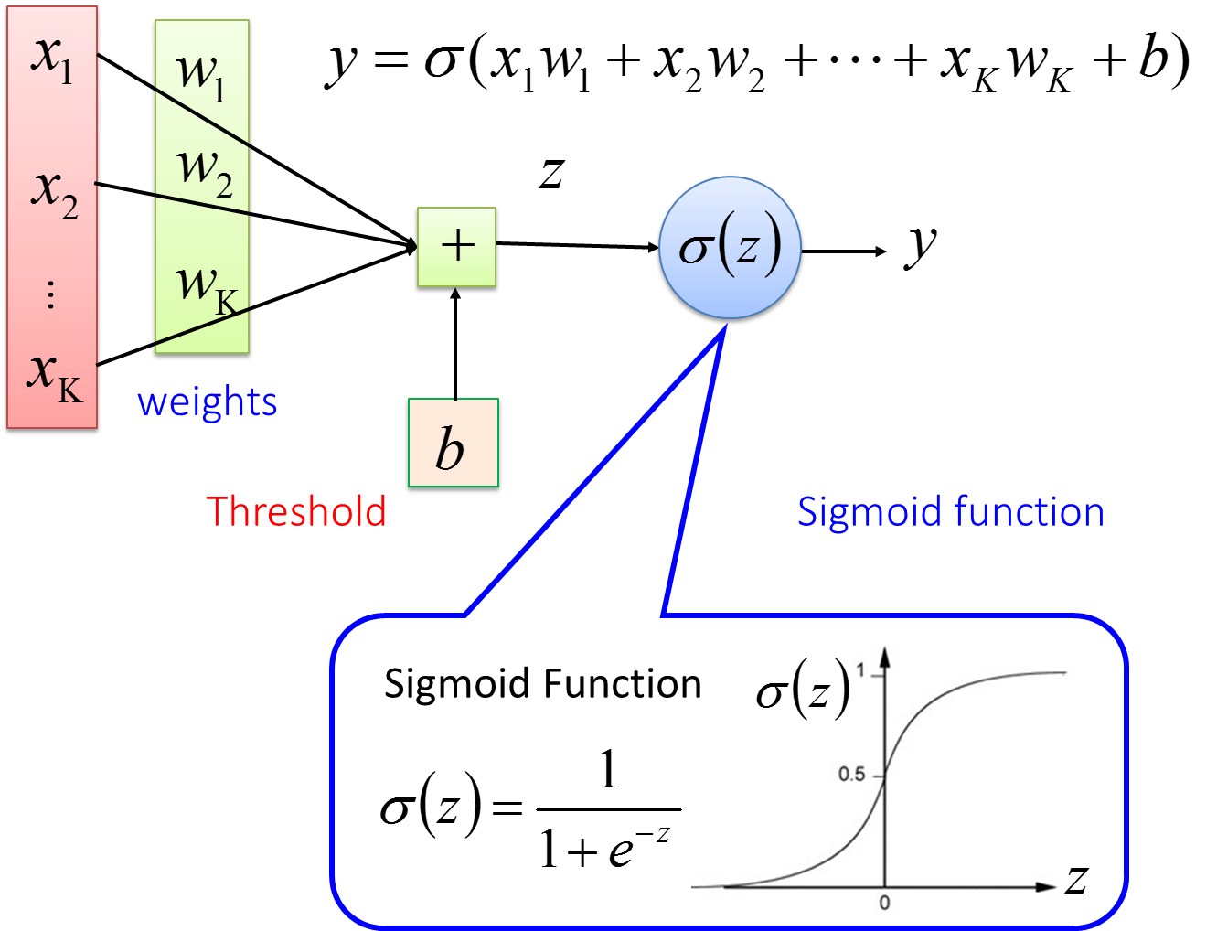
From linear classifiers TO Neural Networks
Recall that this is also logistic regression…
But a non-linearity just at the end of a linear combination doesn’t make any difference (still linear discrimination!)
Notes:
Fully Connected Feedforward Network
You can always connect the neurons in your own way.
“+” is ignored
Each dimension corresponds to a digit (10 dimension is needed)

Slide 9
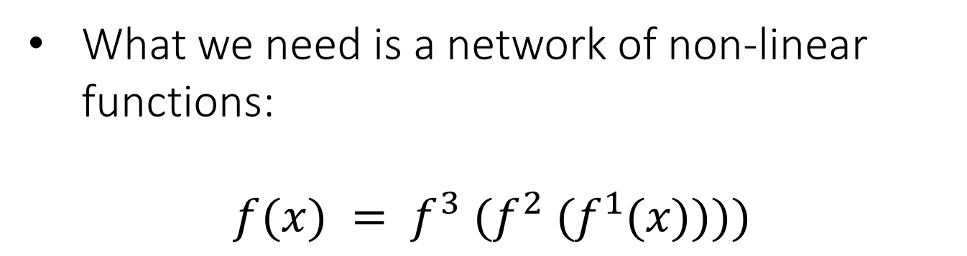
From linear classifiers TO Neural Networks
What we need is a network of non-linear functions:
$$f(x) = f^{3} (f^{2} (f^{1}(x))))$$
Notes:
Fully Connected Feedforward Network
You can always connect the neurons in your own way.
“+” is ignored
Each dimension corresponds to a digit (10 dimension is needed)

Slide 10
Feed Forward Neural Network (from Hung-yi Lee “Deep Learning Tutorial”)
neuron
Input
Layer 1
Layer 2
Layer L
Output
……
y₁
……
y₂
……
……
……
……
……
……
y_{M}
Input Layer
Output Layer
Hidden Layers
Deep means many hidden layers
Notes:
Fully Connected Feedforward Network
You can always connect the neurons in your own way.
“+” is ignored
Each dimension corresponds to a digit (10 dimension is needed)

Slide 11
Fat + Short v.s. Thin + Tall
The same number of parameters
Which one is better?
……
……
……
Shallow
Deep

Slide 12
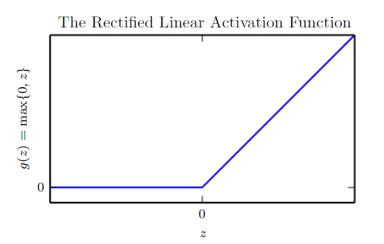
Activation Functions
In modern neural networks, the default recommendation is to use the rectified linear unit or ReLU
…
weights
Discuss why?
Notes:
Fully Connected Feedforward Network
You can always connect the neurons in your own way.
“+” is ignored
Each dimension corresponds to a digit (10 dimension is needed)

Slide 13
Terminology
Example: Network function f: R³ → R²
output vector
y₁
y₂
output layer
hidden layer
input layer
x₁
x₂
x₃
input vector

Slide 14
output vector
y₁
y₂
x₁
x₂
x₃
input vector

Slide 15
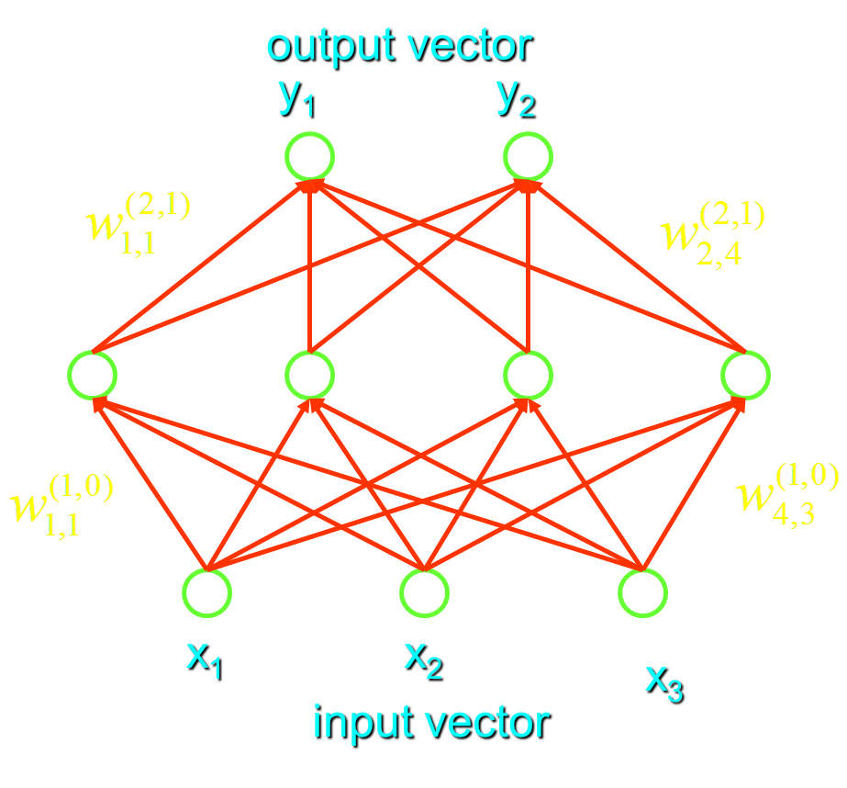
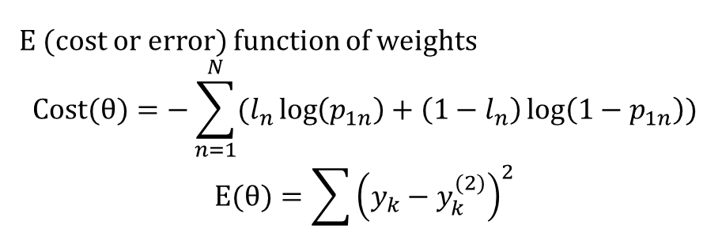
E (cost or error) function of weights
$$Cost(θ)=−\sum_{n=1}^{N}{(l_{n}\log\left(p_{1n}\right)+\left(1−l_{n}\right)\log\left(1−p_{1n}\right))}$$
$$E(θ)=\sum{{\left(y_{k}−y_{k}^{(2)}\right)}^{2}}$$
Backpropagation
For using gradient descent algorithms we need:
Output layer: easy
Hidden layer: difficult

Slide 16
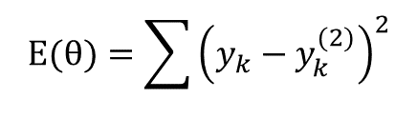
Backpropagation : apply the chain rule
$$E(θ)=\sum{{\left(y_{k}−y_{k}^{(2)}\right)}^{2}}$$

Slide 17

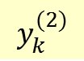
Hidden layer : NOTICE that each influences
each with k=1,… K (2 in our example)
$$E(θ)=\sum{{\left(y_{k}−y_{k}^{(2)}\right)}^{2}}$$
$$y_{k}^{(2)}$$
output vector
y₁
y₂
x₁
x₂
x₃

Slide 18

Hidden layer :
$$E(θ)=\sum{{\left(y_{k}−y_{k}^{(2)}\right)}^{2}}$$

Slide 19
Weight changes :
Output layer
Hidden layer

Slide 20
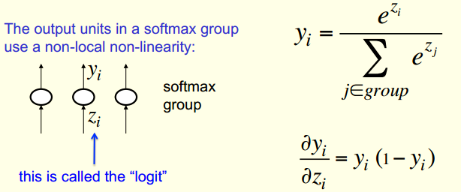
If we remember Softmax function from day-1

Slide 21
Sigmoidal Neurons

Slide 22
Using sigmoid derivative properties :

Slide 23
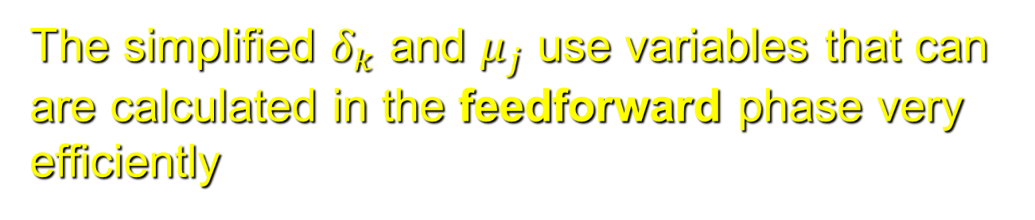
The simplified $δ_{k}$ and $μ_{j}$ use variables that can are calculated in the feedforward phase very efficiently
Output layer
Hidden layer

Slide 24
Algorithm first performs forward propagation, which maps parameters to loss or cost function associated training examples
Then the corresponding computation for applying the back-propagation algorithm is done

Slide 25
Backpropagation algorithm computes the gradient, while another algorithm, such as stochastic gradient descent, is used to perform learning using this gradient

Slide 26
Deep Learning Tutorial
李宏毅
Hung-yi Lee
Notes:
Not memtion
DT v.s. Deep!!!!!

Slide 27
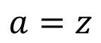
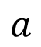
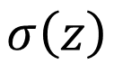
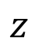
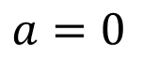
ReLU
Rectified Linear Unit (ReLU)
Reason:
$$a$$
$$σ\left(z\right)$$
1. Fast to compute
$$a=z$$
2. Biological reason
$$a=0$$
3. Infinite sigmoid with different biases
$$z$$
4. Vanishing gradient problem
[Xavier Glorot, AISTATS’11]
[Andrew L. Maas, ICML’13]
[Kaiming He, arXiv’15]
Notes:
Parametric ReLU, -> PReLU
Ref: Glorot, Xavier, Antoine Bordes, and Yoshua Bengio. "Deep sparse rectifier neural networks." International Conference on Artificial Intelligence and Statistics. 2011.
No differentailalbe how about 0
Benefit:
2011
Where does it come from?
fast to compute
biology?
many sigmoid

Slide 28
Vanishing Gradient Problem
……
y₁
In 2006, people used RBM pre-training.
In 2015, people use ReLU.
……
y₂
……
……
……
……
……
……
y_{M}
Smaller gradients
Larger gradients
Learn very slow
Learn very fast
Almost random
Already converge
based on random!?
Notes:
The problem of gradient vanish is very hard to explain ……………….!!!!!!!!!!!!!!!!!!!!!!!!!!!!!!!!!
See Gradient flow in recurrent nets: the difficulty of learning long-term dependencies, by Sepp Hochreiter, Yoshua Bengio, Paolo Frasconi, and Jürgen Schmidhuber (2001). This paper studied recurrent neural nets, but the essential phenomenon is the same as in the feedforward networks we are studying. See also Sepp Hochreiter's earlier Diploma Thesis,Untersuchungen zu dynamischen neuronalen Netzen (1991, in German).
Stuck at a bad local minima
When deep learning is difficult in early year
Need initialization
Another point of view
Definition of gradient

Slide 29
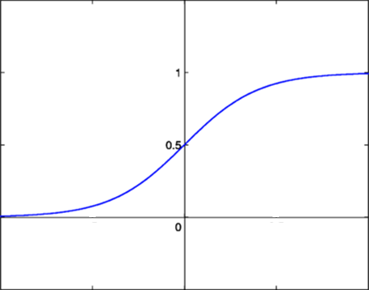
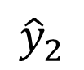
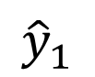
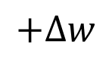
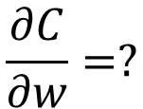
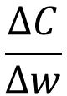
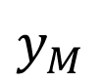
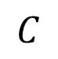
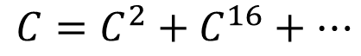
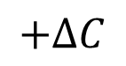
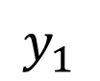
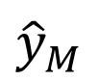
Vanishing Gradient Problem
Smaller gradients
……
$$y_{1}$$
$${\hat{y}}_{1}$$
Small output
……
$$y_{2}$$
$${\hat{y}}_{2}$$
……
……
……
……
……
$$C$$
……
$$+∆C$$
……
$$y_{M}$$
$${\hat{y}}_{M}$$
Large input
$$+∆w$$
Intuitive way to compute the gradient …
$$\frac{∂C}{∂w}=?$$
$$\frac{∆C}{∆w}$$

Slide 30
ReLU
$$a$$
$$a=z$$
$$a=0$$
$$z$$
0
0
0
0

Slide 31
ReLU
$$a$$
$$a=z$$
A Thinner linear network
$$a=0$$
$$z$$
Do not have smaller gradients

Slide 32












Maxout
ReLU is a special cases of Maxout
Learnable activation function [Ian J. Goodfellow, ICML’13]
+
neuron
+
$$5$$
$$1$$
Input
Max
$$7$$
Max
$$2$$
+
$$7$$
+
$$2$$
+
$$−1$$
+
$$4$$
Max
$$1$$
Max
$$4$$
+
$$1$$
+
$$3$$
You can have more than 2 elements in a group.
Notes:
How to train? Latter
2013
Ian J. Goodfellow goodfeli@iro.umontreal.ca David Warde-Farley wardefar@iro.umontreal.ca Mehdi Mirza mirzamom@iro.umontreal.ca Aaron Courville aaron.courville@umontreal.ca Yoshua Bengio

Slide 33
Adaptive learning rate ……
Adagrad [John Duchi, JMLR’11]
RMSprop
https://www.youtube.com/watch?v=O3sxAc4hxZU
Adadelta [Matthew D. Zeiler, arXiv’12]
Adam [Diederik P. Kingma, ICLR’15]
AdaSecant [Caglar Gulcehre, arXiv’14]
“No more pesky learning rates” [Tom Schaul, arXiv’12]
Notes:
Ada delta: http://www.matthewzeiler.com/pubs/googleTR2012/googleTR2012.pdf
Adam: http://arxiv.org/pdf/1412.6980.pdf
AdaSecant
http://arxiv.org/pdf/1412.7419v4.pdf
“No more pesky learning rates”
http://arxiv.org/pdf/1206.1106.pdf
Adasecodn: Yoshua Bengio
No learning rate: Yann LeCun
SECANT: sec (not mentioned)
http://arxiv.org/pdf/1412.7419v4.pdf

Slide 34

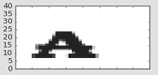
Font type Recognition
Input
Output
Font type
is “2”
reShape
y₁
is 1
0
0.1
1
y₂
is 2
0.7
……
……
……
……
y₁₀
0.2
is N
0
36 x 36 = 1296
Elements [0:255]
White pixel → 0
Black pixel → 255
Each dimension represents the confidence of a char type
OHE
One-Hot-Encoding
Notes:
The same for even more complex tasks.

Slide 35
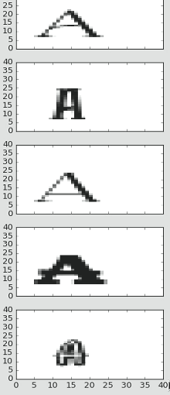
One-hot-encoding (OHE)
Number of
Categories
(N=5)
Categories
Type 1
1 0 0 0 0
0 1 0 0 0
0 0 1 0 0
0 0 0 1 0
0 0 0 0 1
Type 2
Type 3
Type 4
Type 5

Slide 36
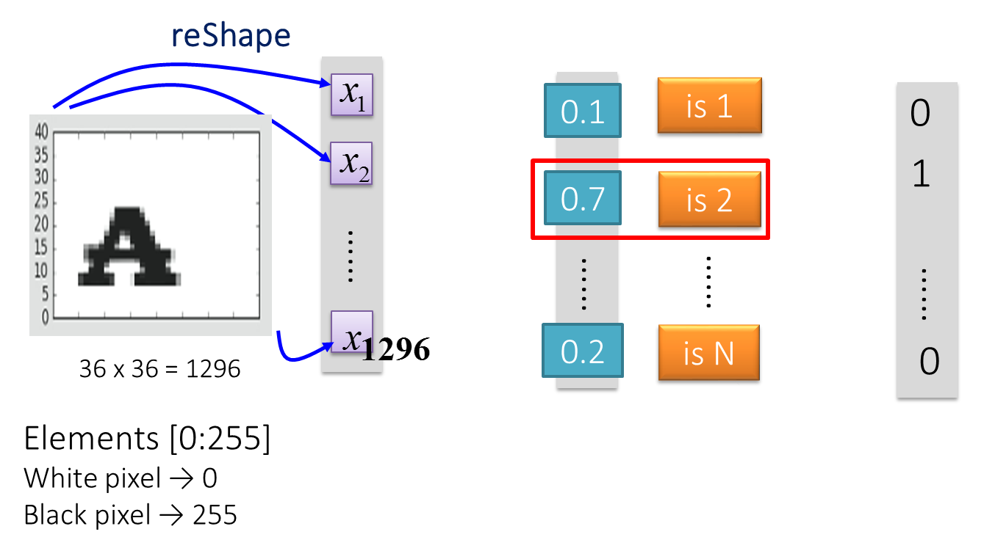
Font type Recognition using Logistic Regression
MSTC_FontReco_LogisticReg.ipynb
Logistic
Regression
Notes:
The same for even more complex tasks.

Slide 37
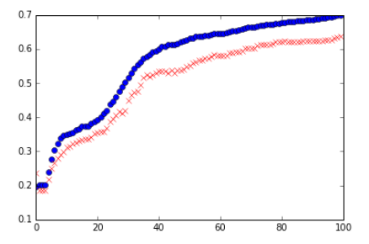
Acc (Train=blue; test=red)
Epoch no.

Slide 38
MSTC_FontReco_FeedForward.ipynb
# These will be inputs…. pixels, flattened
x = tf.placeholder("float", [None, 1296])
## Known labels
y_ = tf.placeholder("float", [None,5])
# Hidden layer 1
num_hidden1 = 128
W1 = tf.Variable(tf.truncated_normal([1296,num_hidden1],
stddev=1./math.sqrt(1296)))
b1 = tf.Variable(tf.constant(0.1,shape=[num_hidden1]))
h1 = tf.sigmoid(tf.matmul(x,W1) + b1)
# Hidden Layer 2
num_hidden2 = 32
W2 = tf.Variable(tf.truncated_normal([num_hidden1,
num_hidden2],stddev=2./math.sqrt(num_hidden1)))
b2 = tf.Variable(tf.constant(0.2,shape=[num_hidden2]))
h2 = tf.sigmoid(tf.matmul(h1,W2) + b2)
Notes:
The same for even more complex tasks.

Slide 39
MSTC_FontReco_FeedForward.ipynb
# Output Layer
W3 = tf.Variable(tf.truncated_normal([num_hidden2, 5],
stddev=1./math.sqrt(5)))
b3 = tf.Variable(tf.constant(0.1,shape=[5]))
# Just initialize
sess.run(tf.initialize_all_variables())
# Define model
y = tf.nn.softmax(tf.matmul(h2,W3) + b3)
### End model specification, begin training code
Notes:
The same for even more complex tasks.

Slide 40
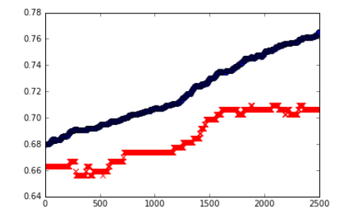
Logistic Regression
Acc (Train=blue; test=red)
Feed Forward
Epoch no.
Acc (Train=blue;
test=red)
Epoch no.

Slide 41
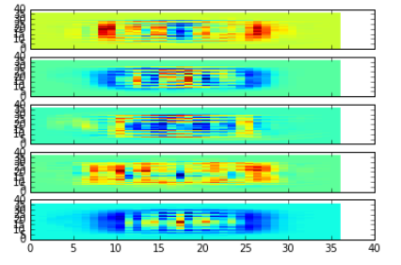
Logistic Regression

Slide 42
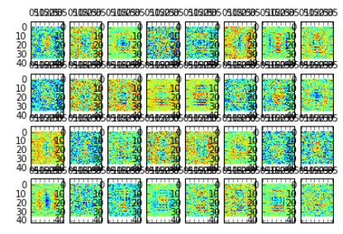
Feed Forward

Slide 43


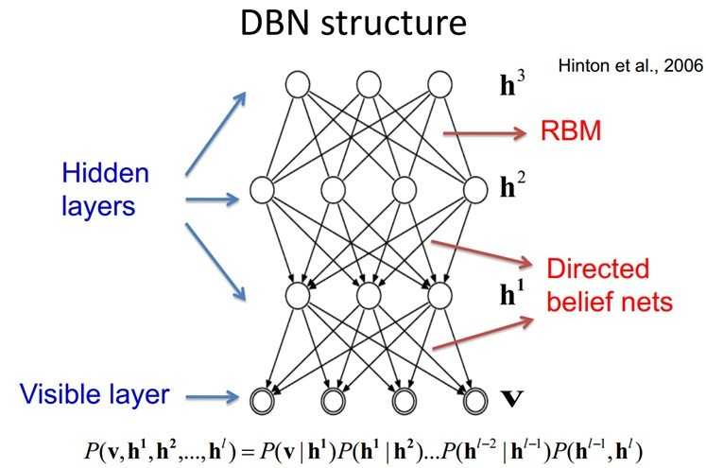
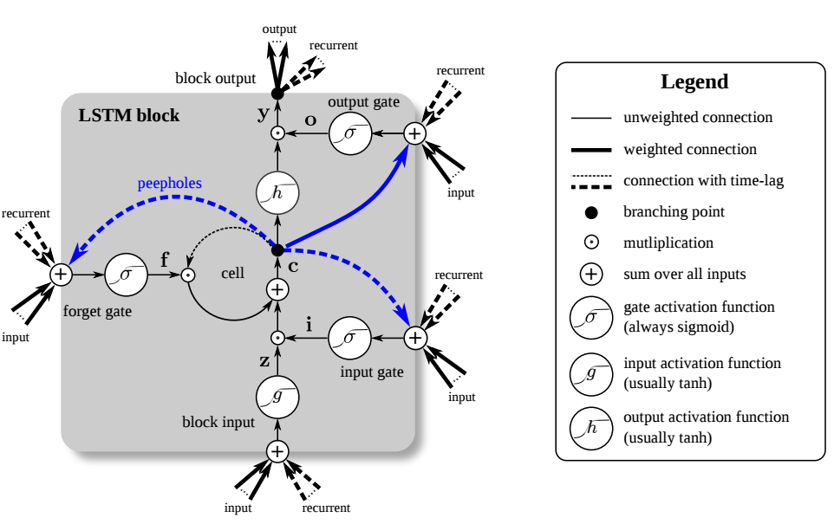
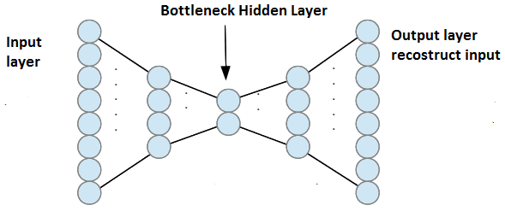
Deep Learning Architectures
Notes:
Not memtion
DT v.s. Deep!!!!!

Slide 44
Unsupervised ?
Notes:
Not memtion
DT v.s. Deep!!!!!

Slide 46
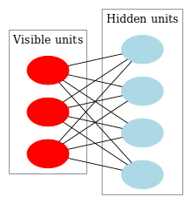
Deep Belief Networks
DBN is a probabilistic, generative model made up of multiple layers of hidden units.
DBN can be used to generatively pre-train a DNN The learned DBN weights as the initial DNN weights.
Back-propagation later for fine-tuning of these weights.
A DBN can be efficiently trained in an unsupervised, layer-by-layer manner, where the layers are typically made of restricted Boltzmann machines (RBM).
RBM: undirected, generative energy-based model with a "visible" input layer and a hidden layer, and connections between the layers but not within layers

Slide 47
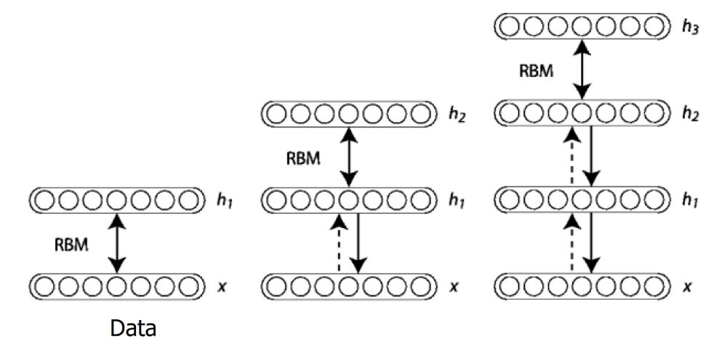
Deep Belief Network Architecture
Once an RBM is trained, another RBM is "stacked" atop it, taking its input from the final already-trained layer.
The new visible layer is initialized to a training vector, and values for the units in the already-trained layers are assigned using the current weights and biases.
This whole process is repeated until some desired stopping criterion is met.

Slide 48
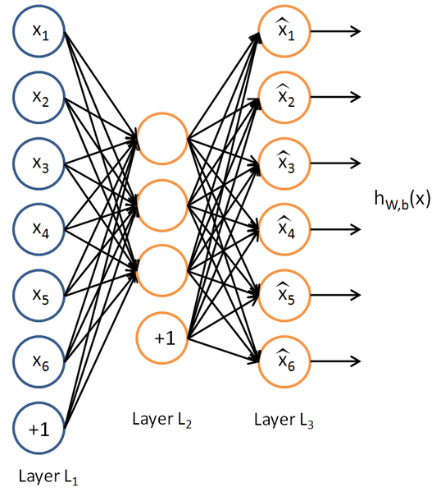
Autoencoder

Slide 49
Autoencoder
Reduce dimensionality, something in common with PCA, but focus more on the reconstruction of the input
Retrieve high level features using unsupervised learning

Slide 52
Avoiding Trivial Identity
Vincent et al. (2010), “a good representation is one that can be obtained robustly from a corrupted input and that will be useful for recovering the corresponding clean input.”

Slide 55

Compression as implicit generative modeling

Slide 56
Supervised:
Feed Forward
CNN: Convolutional Neural Network
RNN: Recurrent Neural Network, LSTM, GRU..
…
Notes:
Not memtion
DT v.s. Deep!!!!!

Slide 57
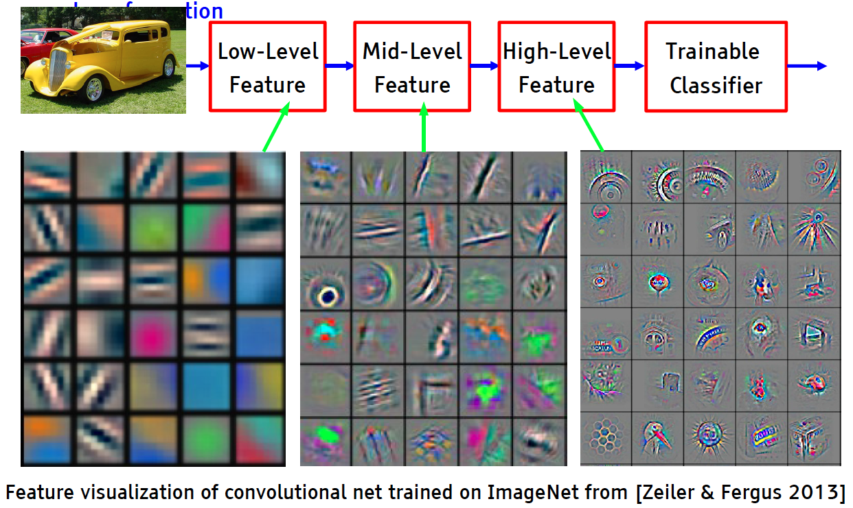
Deep Learning = Learning Hierarchical Representations

Slide 58
CNN: Convolutional Neural Network
Convolutional Neural Network organizes neurons based on animal’s visual cortex system, which allows for learning patterns at both local level and global level.
Y. LeCun, L. Bottou, Y. Bengio and P. Haffner: Gradient-Based Learning Applied to Document Recognition, Proceedings of the IEEE, 86(11):2278-2324, November 1998

Slide 59
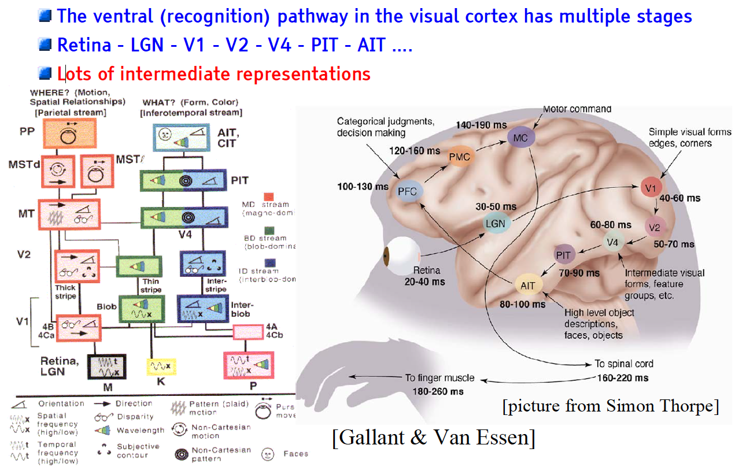
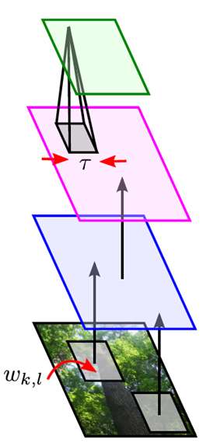
The Mammalian Visual Cortex Inspires CNN
Convolutional Neural Net
output
input

Slide 60
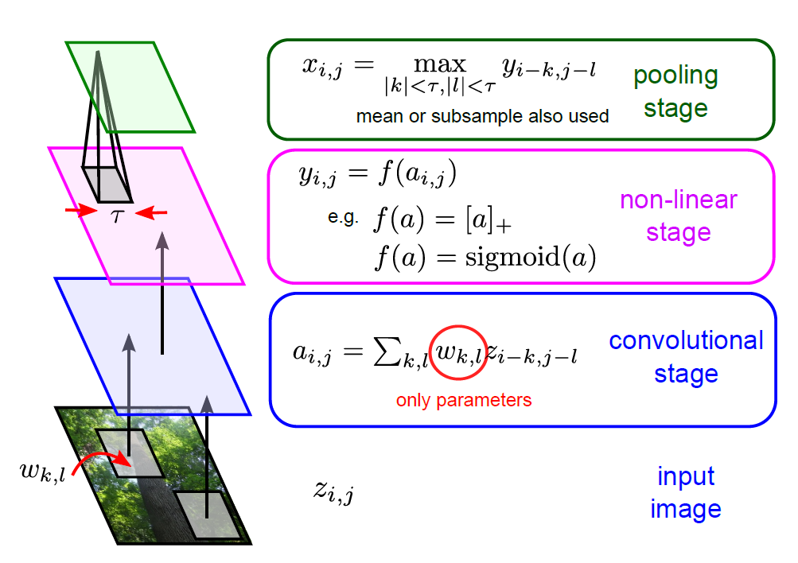
Building-blocks for CNN’s
Feature maps of a larger region are combined.
Feature maps are trained with neurons.
Shared weights
Each sub-region yields a feature map, representing its feature.
Images are segmented into sub-regions.

Slide 61


CNN Architecture: Pooling Layer
Intuition: to progressively reduce the spatial size of the representation to reduce the amount of parameters and computation in the network, and hence to also control overfitting
Pooling partitions the input image into a set of non-overlapping rectangles and, for each such sub-region, outputs the maximum value of the features in that region.
Input

Slide 62
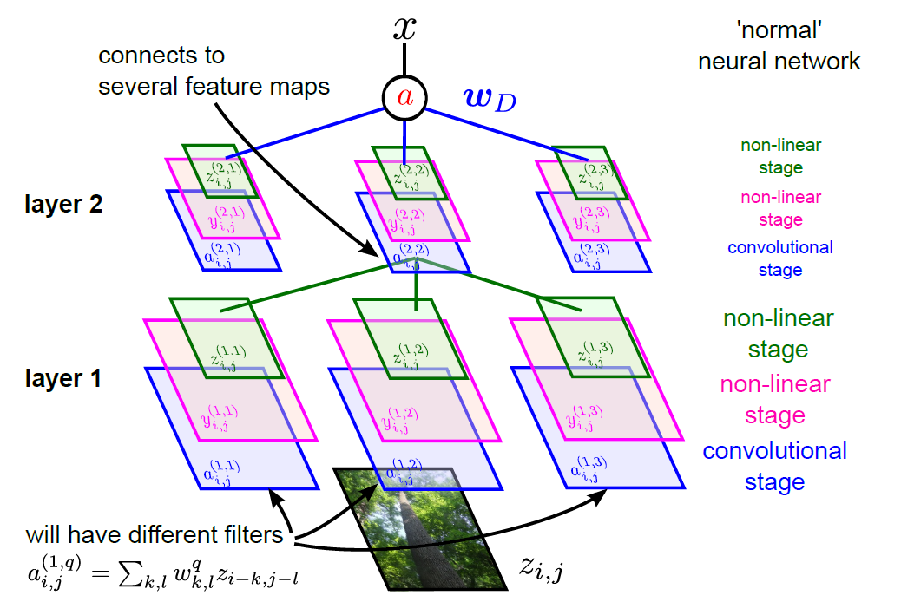
Full CNN
pooling
pooling
See:
https://deeplearning4j.org/convolutionalnets.html

Slide 63
MSTC_FontReco_CNN.ipynb (I)
# Conv layer 1
num_filters = 4
winx = 5
winy = 5
W1 = tf.Variable(tf.truncated_normal([winx, winy, 1 , num_filters], stddev=1./math.sqrt(winx*winy)))
b1 = tf.Variable(tf.constant(0.1, shape=[num_filters]))
# 5x5 convolution, pad with zeros on edges
xw = tf.nn.conv2d(x_im, W1, strides=[1, 1, 1, 1], padding='SAME')
h1 = tf.nn.relu(xw + b1)
# 2x2 Max pooling, no padding on edges
p1 = tf.nn.max_pool(h1, ksize=[1, 2, 2, 1], strides=[1, 2, 2, 1], padding='VALID')
Notes:
The same for even more complex tasks.

Slide 64
MSTC_FontReco_CNN.ipynb (II)
# Need to flatten convolutional output for use in dense layer
p1_size = np.product( [s.value for s in p1.get_shape()[1:]])
p1f = tf.reshape(p1, [-1, p1_size ])
# Dense layer
num_hidden = 32
W2 = tf.Variable(tf.truncated_normal( [p1_size, num_hidden], stddev=2./math.sqrt(p1_size)))
b2 = tf.Variable(tf.constant(0.2, shape=[num_hidden]))
h2 = tf.nn.relu(tf.matmul(p1f,W2) + b2)
# Output Layer
W3 = tf.Variable(tf.truncated_normal( [num_hidden, 5],
stddev=1./math.sqrt(num_hidden)))
b3 = tf.Variable(tf.constant(0.1,shape=[5]))
….
Notes:
The same for even more complex tasks.

Slide 65
MSTC_FontReco_CNN.ipynb (III)
keep_prob = tf.placeholder("float")
h2_drop = tf.nn.dropout(h2, keep_prob)
# Just initialize
sess.run(tf.initialize_all_variables())
# Define model
y = tf.nn.softmax(tf.matmul(h2_drop,W3) + b3)
Notes:
The same for even more complex tasks.

Slide 66
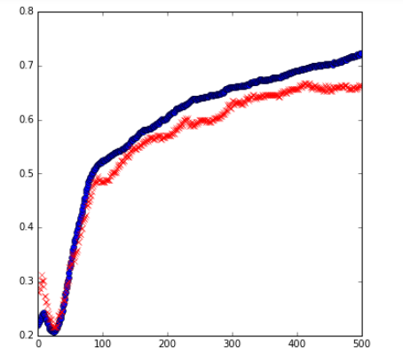
Logistic Regression
Feed Forward
Acc (Train=blue; test=red)
Epoch no.
CNN
Epoch no.
Acc (Train=blue;
test=red)
Epoch no.

Slide 67
Tips for Training DNN
Notes:
The techniques people did not know in 1980s.

Slide 68

Recipe for Learning
http://www.gizmodo.com.au/2015/04/the-basic-recipe-for-machine-learning-explained-in-a-single-powerpoint-slide/
Notes:
今年四月的 GTC

Slide 69
Recipe for Learning
Don’t forget!
overfitting
Modify the Network
Preventing
Overfitting
Better optimization Strategy
http://www.gizmodo.com.au/2015/04/the-basic-recipe-for-machine-learning-explained-in-a-single-powerpoint-slide/
Notes:
Last one is on training set
Sometimes students ask

Slide 70
Tips for Training DNN
Dropout

Slide 71

Dropout
Pick a mini-batch
$$θ^{t}←θ^{t−1}−η∇C\left(θ^{t−1}\right)$$
Training:
Each time before computing the gradients
Each neuron has p% to dropout
Notes:
Iteration v.s. epoch!!!!!!!!

Slide 72
Dropout
Pick a mini-batch
$$θ^{t}←θ^{t−1}−η∇C\left(θ^{t−1}\right)$$
Training:
Thinner!
Each time before computing the gradients
Each neuron has p% to dropout
The structure of the network is changed.
Using the new network for training
For each mini-batch, we resample the dropout neurons
Notes:
Do not worry that someone will not update

Slide 73

Dropout
Testing:
No dropout
If the dropout rate at training is p%, all the weights times (1-p)%
Assume that the dropout rate is 50%.
If a weight $w=1$ by training, set $w=0.5$ for testing.
Notes:
Bias do not have to multiply !!!!!!!!!!!!!!!!!!!!!!!!!!!!!!!!!!!
Reasonable !!!!!!!!!!!!!!!!!!!!

Slide 74
Dropout - Intuitive Reason
我的 partner 會擺爛，所以我要好好做
When teams up, if everyone expect the partner will do the work, nothing will be done finally.
However, if you know your partner will dropout, you will do better.
When testing, no one dropout actually, so obtaining good results eventually.
Notes:
Why the weights should multiply p (dropout rate) at testing?

Slide 75
















Dropout - Intuitive Reason
Why the weights should multiply (1-p)% (dropout rate) when testing?
Training of Dropout
Testing of Dropout
Assume dropout rate is 50%
No dropout
Weights from training
$$w_{1}$$
$$0.5×$$
$$w_{1}$$
$$z^{′}≈2z$$
$$w_{2}$$
$$z$$
$$0.5×$$
$$w_{2}$$
$$z^{′}$$
$$w_{3}$$
$$0.5×$$
$$w_{3}$$
$$w_{4}$$
$$0.5×$$
$$w_{4}$$
Weights multiply (1-p)%
$$z^{′}≈z$$
Notes:
important

Slide 76
Dropout is a kind of ensemble.
Training Set
Ensemble
Set 1
Set 2
Set 3
Set 4
Network
1
Network
2
Network
3
Network
4
Train a bunch of networks with different structures

Slide 77
Dropout is a kind of ensemble.
Ensemble
Testing data x
Network
1
Network
2
Network
3
Network
4
y₁
y₂
y₃
y₄
average

Slide 78
Dropout is a kind of ensemble.
minibatch
1
minibatch
2
minibatch
3
minibatch
4
Training of Dropout
M neurons
……
2^{M} possible networks
Using one mini-batch to train one network
Some parameters in the network are shared

Slide 79
Dropout is a kind of ensemble.
Testing of Dropout
testing data x
All the weights multiply (1-p)%
……
y₁
y₂
y₃
average
≈
y
Notes:
0,0 -> 0
1,0 -> 1
0,-1 -> -2
1,-1 -> -1
½, -1/2 -> -0.5
1,2
Geometric Mean?

Slide 80
More about dropout
More reference for dropout [Nitish Srivastava, JMLR’14] [Pierre Baldi, NIPS’13][Geoffrey E. Hinton, arXiv’12]
Dropout works better with Maxout [Ian J. Goodfellow, ICML’13]
Dropconnect [Li Wan, ICML’13]
Dropout delete neurons
Dropconnect deletes the connection between neurons
Annealed dropout [S.J. Rennie, SLT’14]
Dropout rate decreases by epochs
Standout [J. Ba, NISP’13]
Each neural has different dropout rate

Slide 81
Logistic Regression
Acc (Train=blue; test=red)
Feed Forward
Epoch no.
Acc (Train=blue;
test=red)
Epoch no.

